Slide 1

Jason Lubrano, Sky Ruff, Erika Bailon,
Thomas Alder, Dennis Nguyen, Javier Ramirez,
Chakrya Ros, Cassidy Carpenter
Notes:
Team member introductions
Team name, logo (if applicable)
Sponsoring organization, description, mission

Slide 2
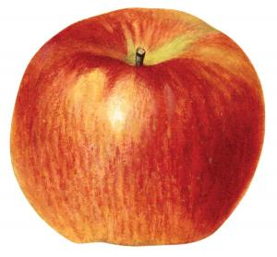
Project Recap & Overview
CU Boulder EBIO Department and Boulder Apple Tree Project (BATP) dedicates their efforts to preserving and protecting the apple variety in Boulder, Colorado.
Our senior design team will work on a interactive user interface to share the data that is now owned by the Boulder Apple Tree Project.
Together, we can help promote appreciation and preservation of apples, their genetic families, and their connection to the history of Boulder.
Notes:
Jason

Slide 3
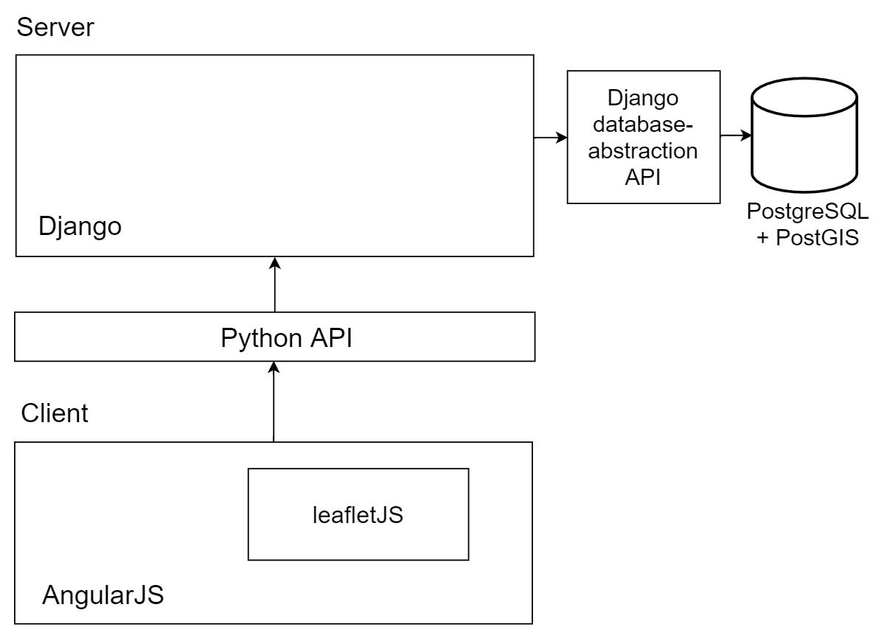
Describe / Diagram the Architecture and High-Level Design of the solution you’re building
Front End:
Angular Components
Leaflet map w/ OpenSourceMap Tiles or custom GeoJSON for historical maps
Python API to get apple data for rendering icons on map and displaying info
Notes:
Thomas

Slide 4
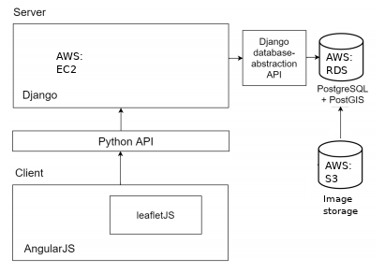
Describe / Diagram the Architecture and High-Level Design of the solution you’re building
Back End:
Heavily using AWS
RDS (with PostgreSQL)
S3
EC2 (with Python and Django)
Notes:
Sky

Slide 5
Overall Project Plan
Front End
 | November | December | January | February | March | April
Erika | 9th - Figma Design | 10th - Class Design. Hit End Points with Dennis | 28th - Angular Code Running | 25th - Features Added | 24th - General Integration | 1st- Deployment
Thomas |  | 10th - Class Design | 28th - Angular Code Running | 25th - Features Added | 24th - General Integration | 1st- Deployment
Chakrya |  | 3rd - Optimize Data |  | 11th - Leaflet Integrated 25th - Unit Test/E3e | 17th - Test completed | 1st- Deployment
Major Deliverables:
Interactive Map
Features:
Obscured Tree Location
Timeline
Display Tree information/Images
Notes:
Erika

Slide 6
Overall Project Plan
Back End
 | November | December | January | February | March | April
Jason |  | 21st - Python API working. BE Server & AWS |  |  | 24th - General Integration | 1st- Deployment
Sky | 9th - Integrate Design. 12th - Clean Data 19th Schema | BE Server & AWS |  |  |  | 1st- Deployment
Dennis |  | 21st - Python API working Hit End Points with Erika |  |  | 24th - General Integration | 1st- Deployment
Cassidy | 12th - Clean Data 19th Schema | 3rd - Optimize Data. 24th- Communication of DB |  |  |  | 1st- Deployment
Javier |  | 21st - Python API working |  | 11th - Unit/E3e Test | 17th - Test completed | 1st- Deployment
Deliverable are planned to take 2 to 4 weeks based on difficulty, each person is responsible for certain tasks sometimes working in groups depending on how large the task is, and the major deliverable is set for April and make any adjustments as needed.
Major deliverables, features, timeline
Team member assignments to tasks
Clean up cassidy’s planning chart with dates
When gantt chart is created, include a slide for it
Notes:
Javier

Slide 7



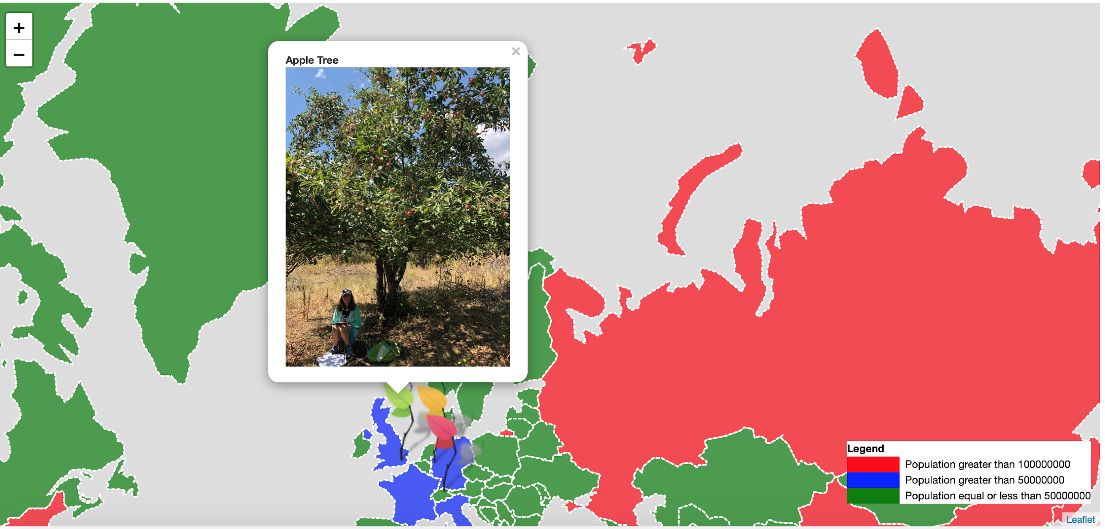
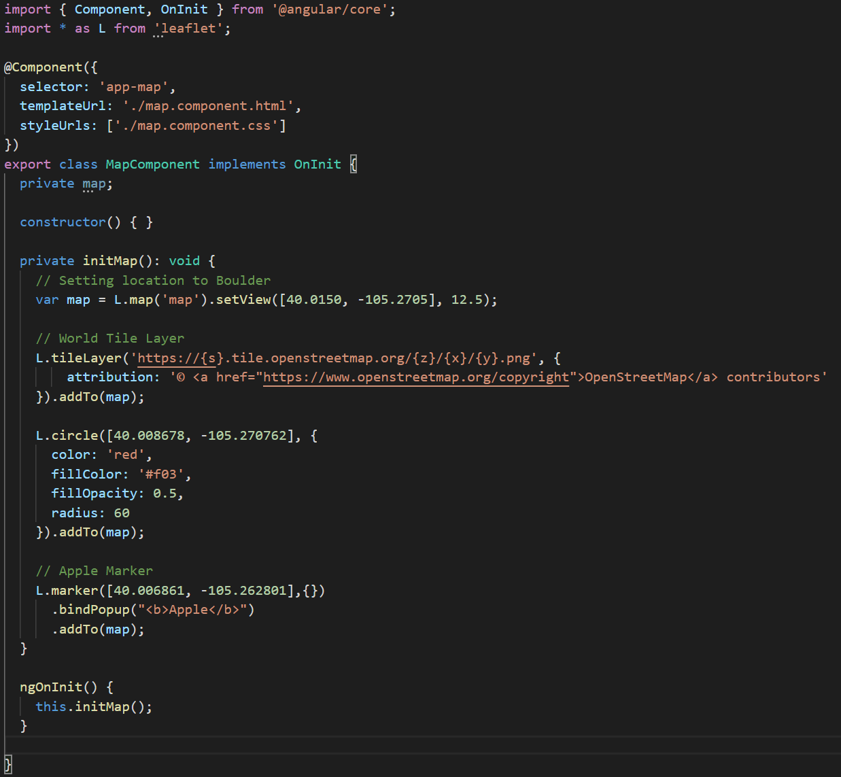
Summary of work completed so far and Major accomplishments.
Angular
Django
LeafLet (mapping)
Notes:
Chakrya
Did you guys want to do a live demo of this or what?

Slide 8
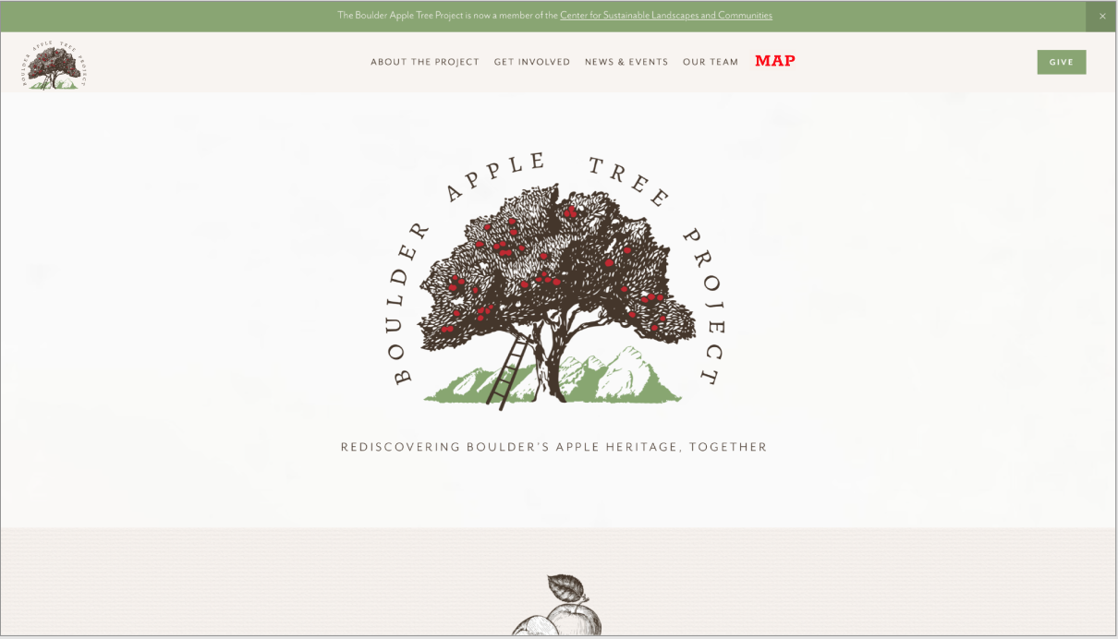
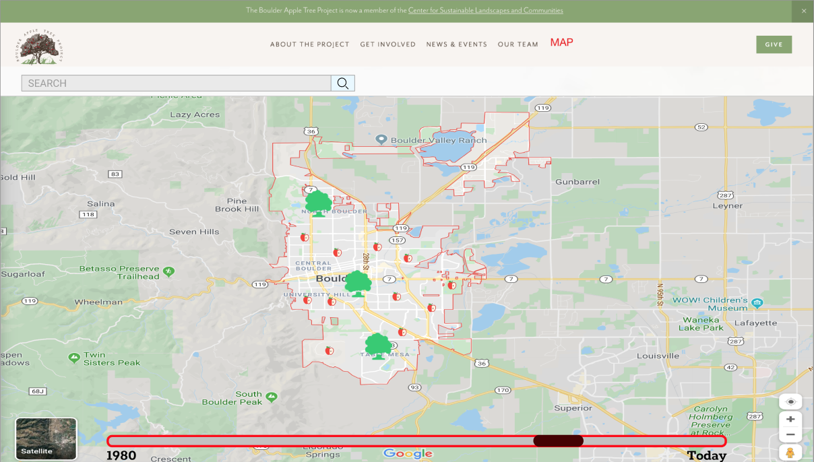
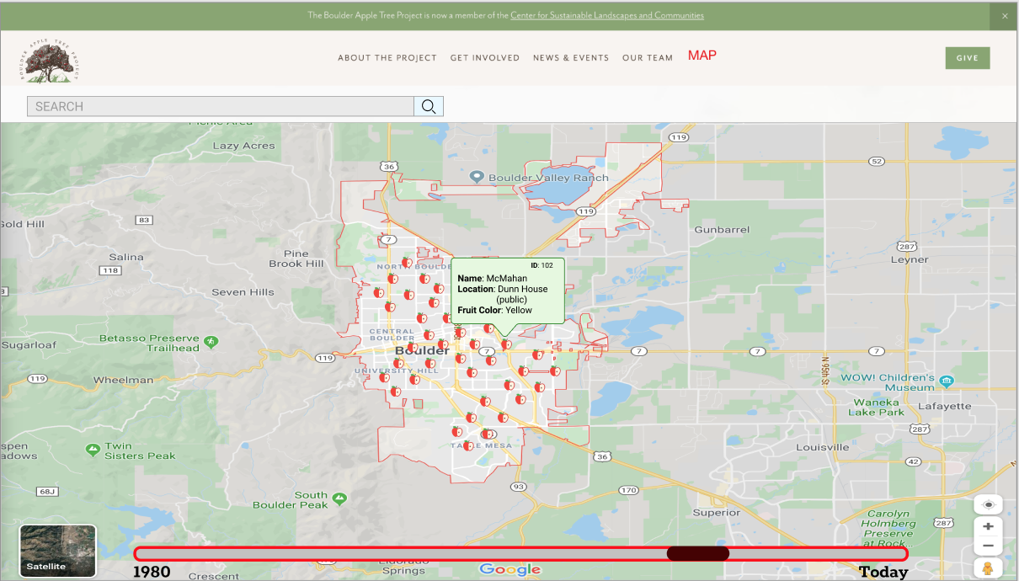
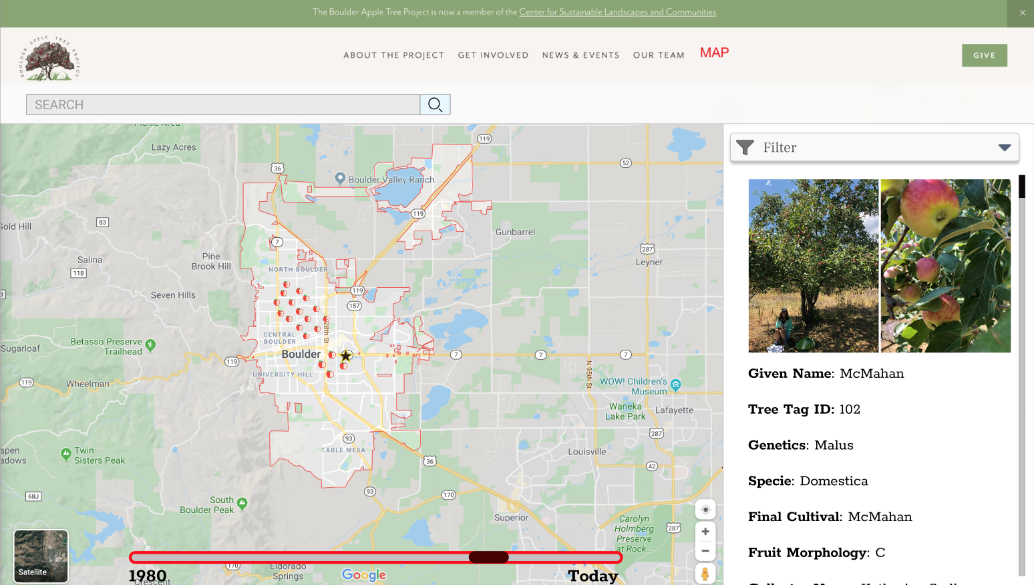
Notes:
Chakrya

Slide 9



Summarize major challenges faced and how you overcame them. (“Lessons Learned” so far)
Scheduling meeting times
Create polls & communicate
Budget Concerns
Be reasonable
Reevaluate scope
How to Handle unorganized data
Talk to sponsor
Ask about filling in missing data
Notes:
Cassidy

Slide 10
Rate your progress so far (rated against your own expectations)
How many stars (out of five) do you give your team?
5/5
How many stars (out of five) do you give your sponsor?
5/5
Notes:
Dennis
I added some neat starts - Jason

Slide 11
Questions?
jason.lubrano@colorado.edu

